Slide 1
Status related consumption in the sub-Saharan Africa
Year 3 (PT) report - Anurag Srivastava
Department of Economics
a.srivastava@pgr.reading.ac.uk

Slide 2
Conspicuous consumption (recap)
The tendency of consumers to indicate status by using goods of a higher quality or in higher quantity than what might be considered necessary
Veblen argued that signalling of status is innate in societies.
More recently, Frederic Hirsch and Robert Frank have argued for status needs to be considered in consumption

Slide 3
Can status consumption exist in sub-Saharan Africa?
While status consumption can always exist, scarcity is more relevant in the developing countries
A definition of status item still suffers with circularity – since the characteristics and items limited to the rich result in status being developed – while status items themselves are meant to enhance status. One requires a feedback model to understand the signalling mechanism.
A survey on visible consumption proxies a lot of the factors that influence a consumer’s choice

Slide 4
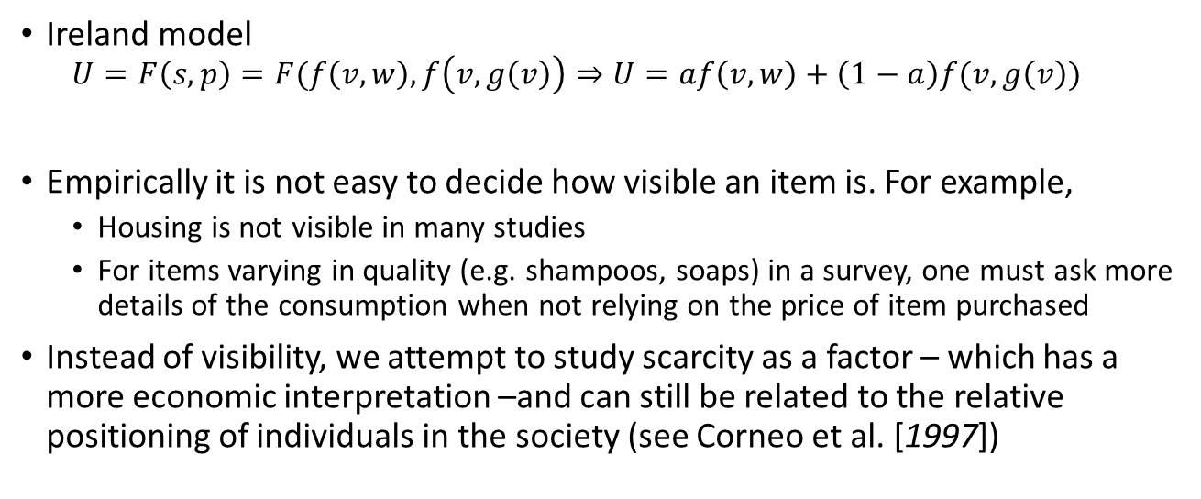
Visible consumption and Status-related consumption
Ireland model
$$U=F\left(s,p\right)=F(f\left(v,w\right),f\left(v,g\left(v\right)\right)⇒U=af\left(v,w\right)+\left(1−a\right)f(v,g\left(v\right))$$
Empirically it is not easy to decide how visible an item is. For example,
Housing is not visible in many studies
For items varying in quality (e.g. shampoos, soaps) in a survey, one must ask more details of the consumption when not relying on the price of item purchased
Instead of visibility, we attempt to study scarcity as a factor – which has a more economic interpretation –and can still be related to the relative positioning of individuals in the society (see Corneo et al. [1997])

Slide 5
How do consumers choose items for status?
A consumer hardly purchases a item that gives status utility alone
Instead, there exists a tendency to accumulate assets and seek permanence (reduce volatility in a permanent income sense). In this sense, education too is an asset
Those who consistently buy high priced items and own more expensive assets would have higher status (in the PI sense)
Market forces i) making assets available for cheap and ii) introducing new assets to replace old –form the range of snob and bandwagon items in the market
Notes:
Status is implied

Slide 6
Identity and barriers
Asset ownership tendencies connect with the snob and bandwagon items in the market through identity of ownership (see Corneo et al. [1997])
The barriers to status represent expectations that shape observed status in society. These can be seen as state variables.
In summary, the choices that the representative consumer faces to enhance status (in the model) are:
Satisfying immediate status needs (purchasing items for nondurable consumption)
Satisfying long-term status needs (through accumulation of assets)
Establishing social networks through non-consumption means

Slide 7
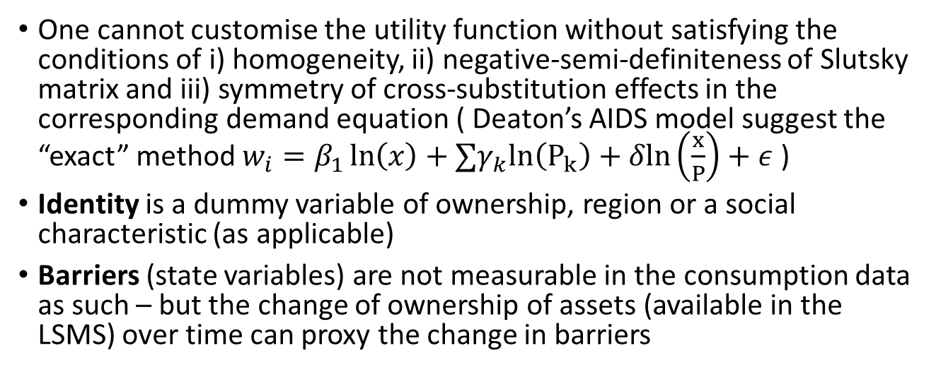
Issues in empirical measurement
One cannot customise the utility function without satisfying the conditions of i) homogeneity, ii) negative-semi-definiteness of Slutsky matrix and iii) symmetry of cross-substitution effects in the corresponding demand equation ( Deaton’s AIDS model suggest the “exact” method $w_{i}=β_{1}\ln\left(x\right)+∑γ_{k}ln\left(P_{k}\right)+δln\left(\frac{x}{P}\right)+ε$ )
Identity is a dummy variable of ownership, region or a social characteristic (as applicable)
Barriers (state variables) are not measurable in the consumption data as such – but the change of ownership of assets (available in the LSMS) over time can proxy the change in barriers

Slide 8
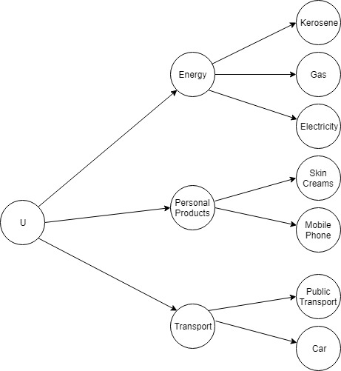
A two state budgeting model
Status is aggregated across all categories. There is no status item per se but – it exists as a separable need within every category.
Linear aggregation of status sub-utilities is assumed
Snob and Bandwagon items are reinterpreted as
High-price selection which represents Veblen’s invidious comparison
Asset substitution which represents Veblen’s pecuniary emulation

Slide 9

Econometric methods in a cross sectional analysis
For high-price selection
$w=β_{1}ln\left(x\right)+β_{2}z+I_{high}+ε_{1}$
$w_{hl}=β_{3}ln\left(x_{c∈C}\right)+β_{4}z+ε_{2}$
For asset-substitution
$w_{c∈C}=β_{1}ln\left(x\right)+{β_{2}z}_{i}+β_{3}A+ε_{1}$
$ζ=\frac{ln⁡(q_{c∈C})}{A}=β_{4}ln\left(x\right)+{β_{5}z}_{i}+ε_{2}$

Slide 10
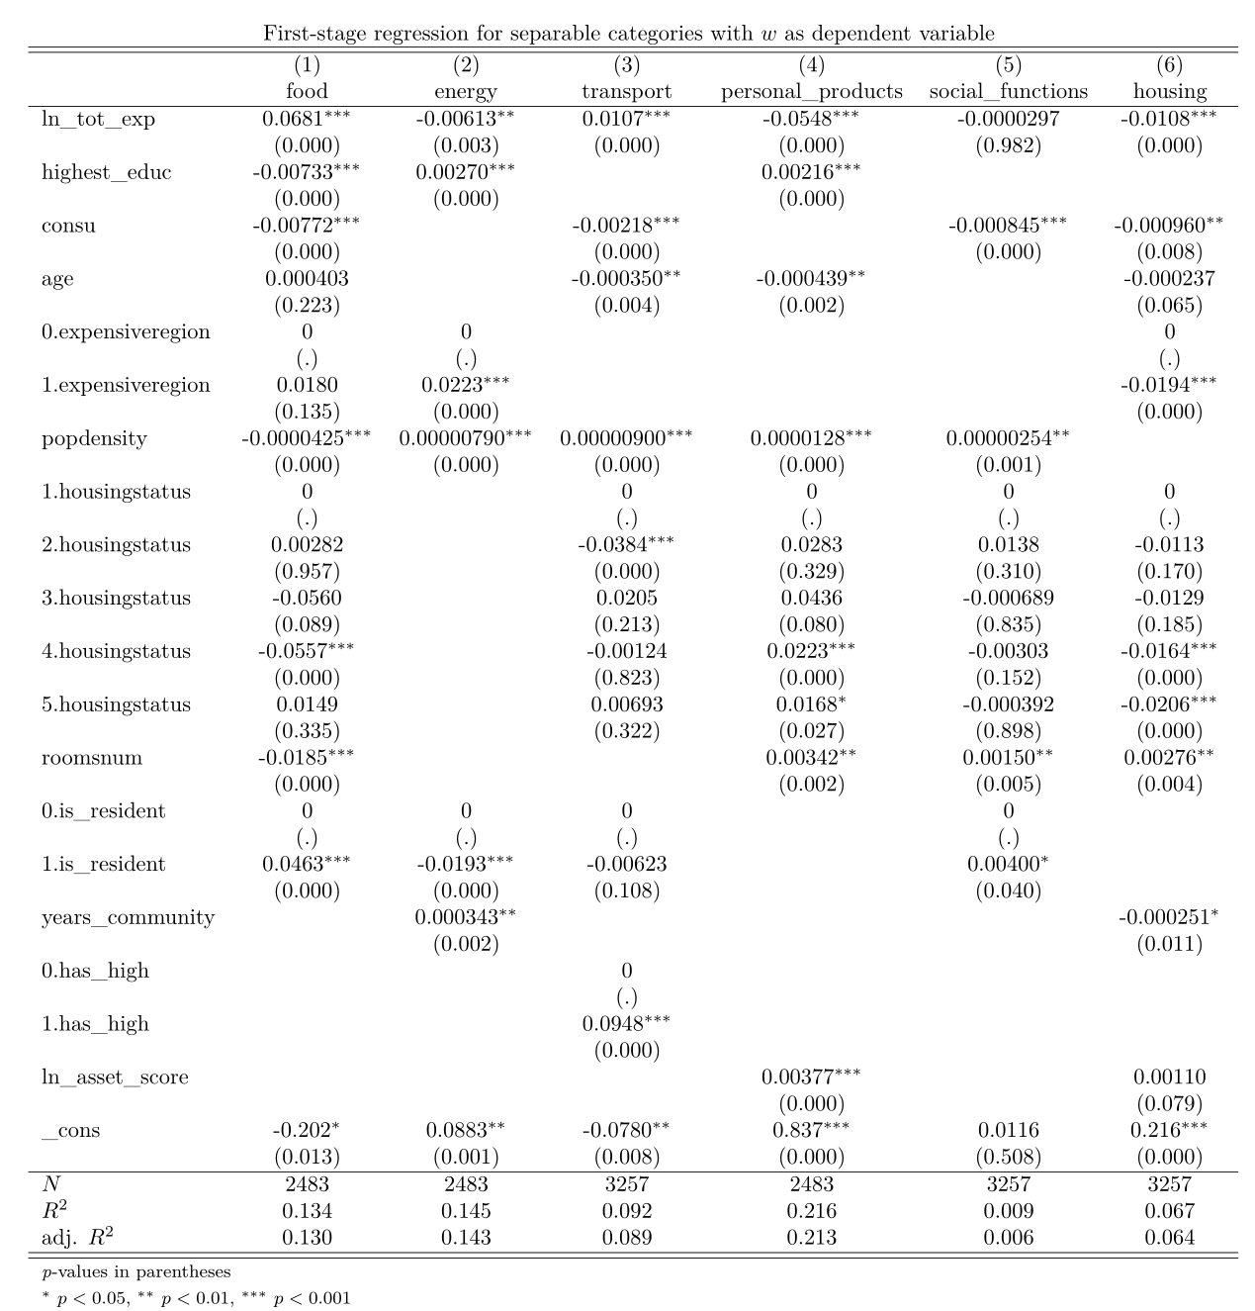
Results(1)

Slide 11
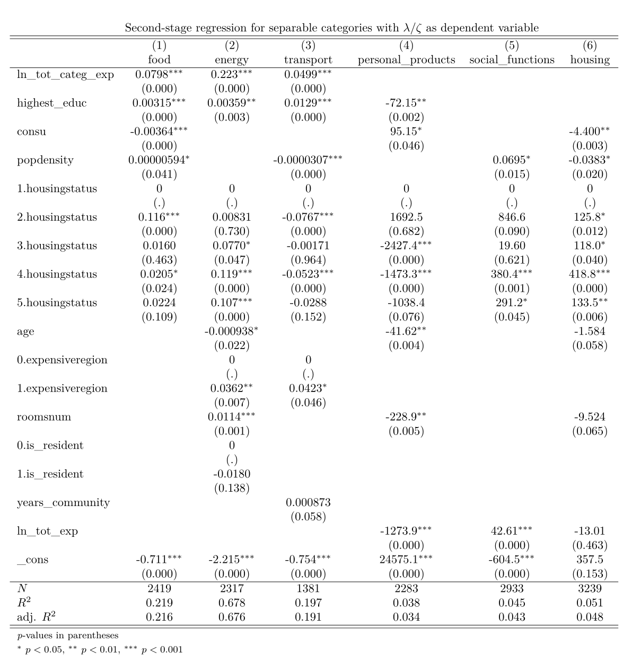
Results(2)

Slide 12
Future Directions
Study the effect of changing ownership of assets
Compare the results from the time-series data with those in the developed economies
Conduct a game that lets players balance status and non-status needs

Slide 13
References
Norman J Ireland, "On limiting the market for status signals", Journal of Public Economics (1994)
Fred Hirsch, Social Limits to Growth (Routledge and Kegan Paul Ltd, 1977)
Robert H Frank, Choosing the Right Pond (OUP USA, 1993)
Angus Deaton and John Muellbauer, Economics and consumer behaviour (Cambridge University Press, 1980)
Giacomo Corneo and Olivier Jeanne, Conspicuous consumption, snobbism and conformism, Journal of Public Economics(1997)

Slide 14
Questions

